Slide 1
Hotel Management System – PL/SQL Project
Problem Definition:
The adoption of manual booking systems creates operational problems for hotels because reception staff experience overbooking along with poor record management and inadequate service tracking systems and billing errors. An automated Hotel Management System development project addresses operations streamlining through its implementation of PL/SQL technology.
Context:
The system operates in hotels along with resorts and guesthouses to handle reservations and room availability together with billing processes and customer record management.
Target Users:
The Hotel Managers will be responsible for both overseeing operations while they monitor reports.
Receptionists – Manage reservations, check-ins, and check-outs.
Hotel guests can perform bookings and request hotel services together with payment transactions.
Financial management staff uses their skills to maintain transaction and financial record sections.
Project Goals:
A system should automate all aspects of hotel bookings together with front-desk procedures.
The system helps to remove mistakes from bills as it increases billing precision.
The system enables secure storage of customer and staff member files alongside payment information.
The hotel operating system must work smother to increase effectiveness.

Slide 2
Key Entities & Relationships
The system will use a relational database model with multiple entities and relationships.
Main Database Tables:
Guests – Stores customer details (Guest ID, Name, Contact, Email).
Rooms – Manages room details (Room ID, Type, Price, Status).
Bookings – Tracks reservations (Booking ID, Guest ID, Room ID, Check-in & Check-out Date).
Payments – Handles financial transactions (Payment ID, Booking ID, Amount, Date, Payment Method).
Employees – Manages hotel staff (Employee ID, Name, Role, Contact, Salary).
Services – Additional hotel services (Service ID, Service Type, Cost).
Service Requests – Tracks guest service requests (Request ID, Guest ID, Service ID, Request Date).
Relationships:
A Guest can make multiple Bookings.
A Booking is associated with one Room.
A Guest makes Payments for bookings.
An Employee handles multiple Bookings and Service Requests.
Guests can request multiple Services during their stay.

Slide 3
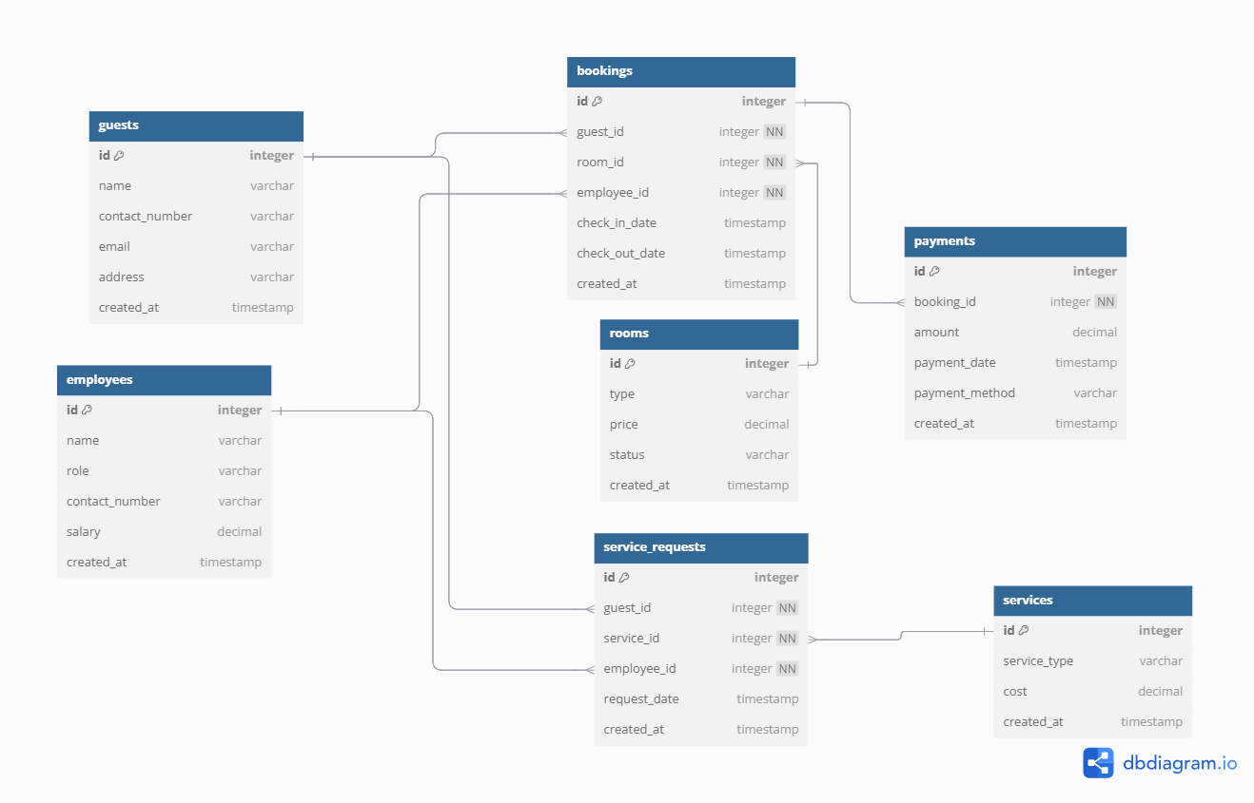
Expected Benefits
Expected Benefits:
Automates reservations – Prevents double bookings and ensures accurate room allocation.
Improves billing accuracy – Generates invoices automatically and links payments to bookings.
Enhances customer experience – Allows guests to book rooms and services seamlessly.
Ensures data security – Uses role-based access control for different user levels.
Reduces manual workload – Employees can focus on service rather than paperwork.
Provides reports and insights – Managers can track occupancy rates, revenue, and performance.

